Slide 1
DevSecOps and PaaS Solutions
March 05, 2020

Slide 2
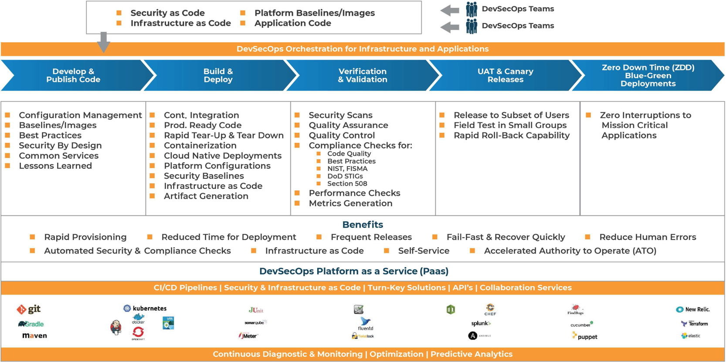
devsecops orchestration continuous Integration & Continuous Delivery (CI/CD)

Slide 3
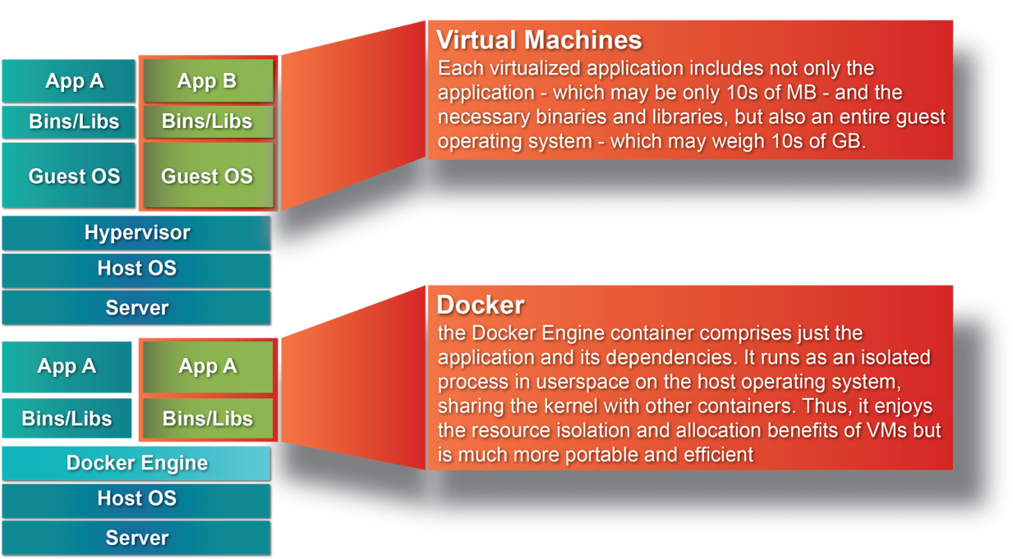
Platform as a service (pAAS)
CONTAINERIZE APPICAITON BUILDs AND SOFTWARE LIBRARIES
Package Once and Deploy Anywhere
Immutable and Reusable
Standardized Environments
Effective Configuration Management
Portability and Integrity
Cloud Readiness
Interoperability
Infrastructure as Code
Security as Code / ATO
Rapid Provisioning and Scaling

Slide 4
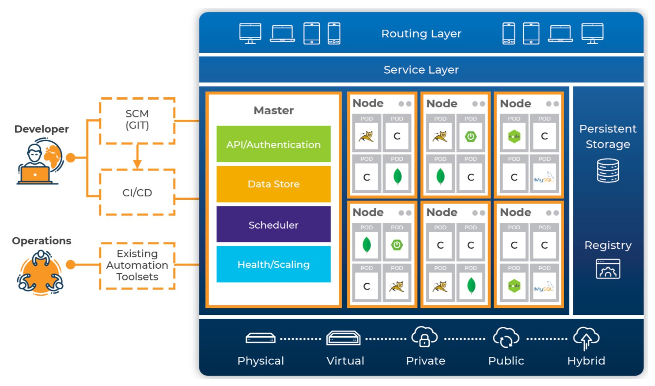
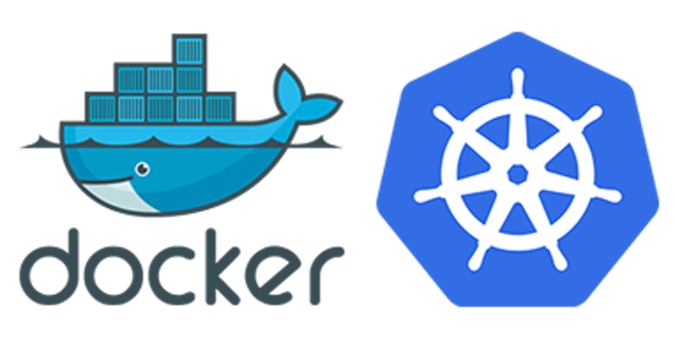
Platform as a service (pAAS)
Kubernetes based container orchestration
  On Premise, Hybrid and Multi-Cloud
Turnkey Solutions
  Service Catalog / Templates
  Rapid Provisioning/Scaling
  Security and ATO
  Zero Downtime Deployments (ZDD)
  Self-Healing
  Monitoring and Logging
  AIOPs
Turnkey Platformsernetes
  Kubernetes
  Openshift
  Redhat Openshift
  Google Cloud (GKE)
  AWS (ECS, EKS)
  AZURE (CS, KS)

Slide 5
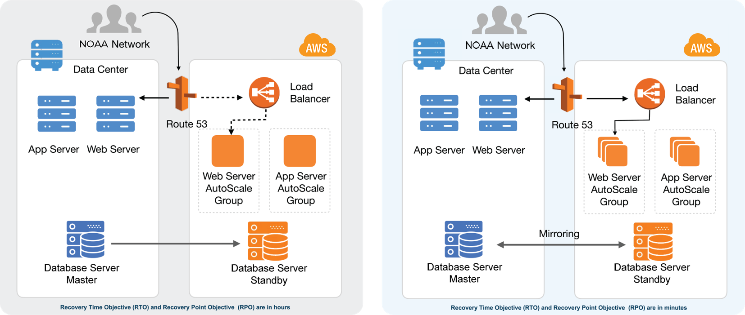
Platform as a service (pAAS)
Disaster recovery and failover - Kubernetes based orchestration
Warm Standby Active - Active

Slide 6
NEXT STEPS
Conduct initial Discovery Sessions with SDB, ISDB and WCCIS teams
Work with WCCIS team to identify and leverage existing services
Demonstrate solutions developed by AceInfo Center of Excellence
Prioritize the findings and improvements required and plan for implementation
Collaborate with WCCIS team to implement DevSecOps and PaaS solutions in phased manner

